Slide 1

CLUSTERING AND INDUCTIVE LOGIC PROGRAMMING (ILP)
A Comparative Overview

Slide 2


Clustering
Unsupervised learning technique that groups similar data points without labeled data.
Inductive Logic Programming (ILP)
Supervised machine learning approach that learns logical rules from examples and background knowledge.
Key Differences
Clustering uses unlabeled data for grouping, while ILP uses labeled data to generate rules.

Slide 3
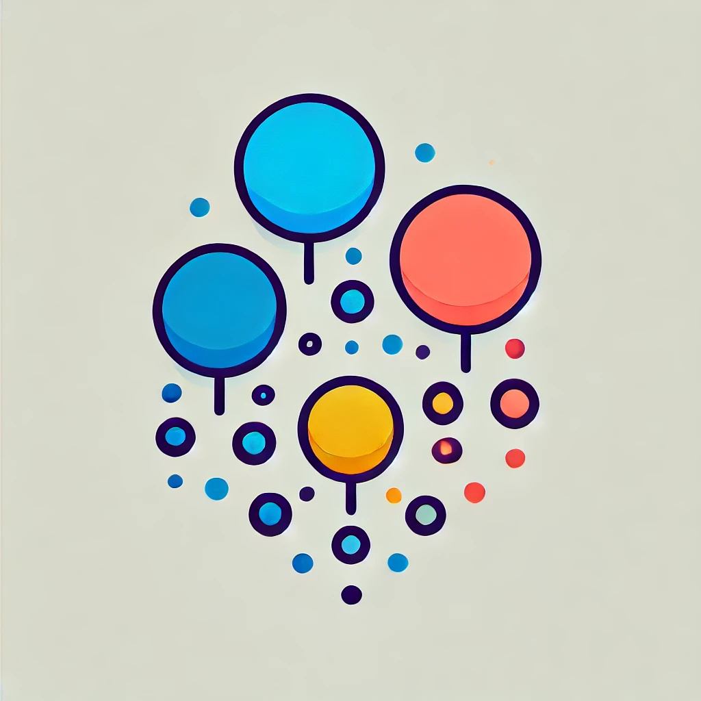
Clustering Overview and Applications
Overview
Unsupervised learning from unlabeled data points, ideal for exploratory analysis, outlier detection, and various data types.
Applications
Applications include image segmentation, customer and document clustering, healthcare, market analysis, fraud detection, and trend analysis.

Slide 4
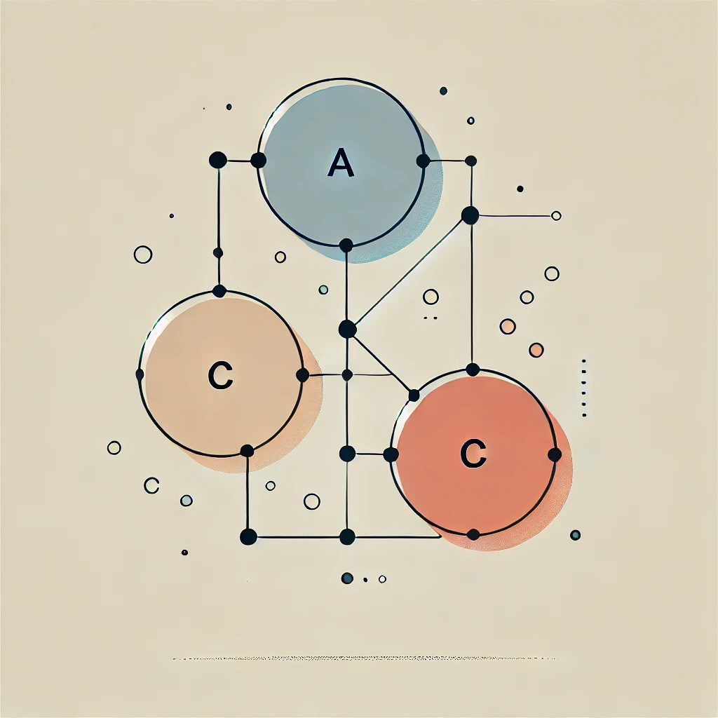

Clustering Strengths and Limitations
Strengths
Works with various data types, ideal for exploration, and identifies outliers.
Limitations
Requires manual selection of clusters (k), hard-to-explain results, and struggles with large datasets.

Slide 5

Key Clustering Algorithms
1
K-Means
Clusters data based on similarity.
2
Hierarchical Clustering
Creates nested clusters.

Slide 6

ILP Overview and Applications
Overview
Symbolic machine learning that learns logical rules from examples and background knowledge.
Explainable AI method using symbols and logic instead of numbers.
Applications
Fraud detection, game AI, robotics, medical diagnosis, and legal reasoning.

Slide 7
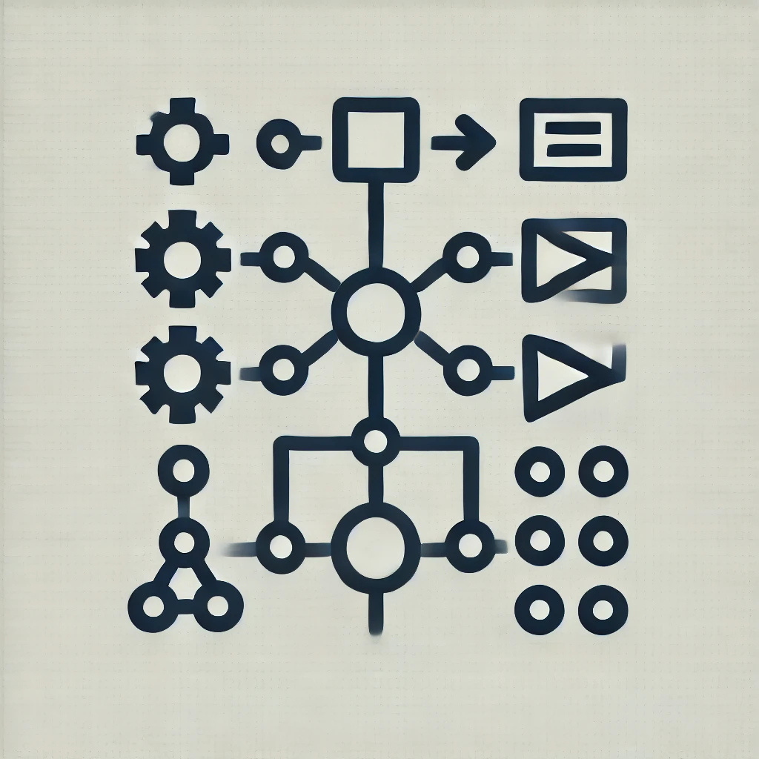
How ILP Works
1
Induction
Moves from facts to rules.
Enhances learning with background knowledge.
2

Slide 8

ILP Strengths and Limitations
Strengths
Interpretable rules, works with small datasets, uses background knowledge, and handles complex data.
Limitations
Computationally expensive, needs labeled examples, not ideal for numerical data.

Slide 9
Clustering | ILP
Unsupervised learning | Supervised learning
Works with unlabeled data | Requires labeled data
Groups data into clusters | Generates logical rules
Hard to explain results | Highly explainable rules
Numerical feature-based | Symbolic logic-based

Slide 10

Conclusion
1
Clustering is effective for exploratory grouping with unlabeled data.
2
ILP excels in learning interpretable rules from labeled examples.
3
Choosing between them depends on the problem and data type.

